Slide 1
ethereum
Lu Yu
The Holcombe Department of Electrical & Computer Engineering

Slide 2
Introduction
What is Ethereum?
Another cryptocurrency.

Slide 3
Introduction
What is Ethereum?

Slide 4
Introduction
What is Ethereum?
A platform allowing users to implement decentralized applications (Dapps) using the blockchain technology.

Slide 5
Introduction
What is Ethereum?
A platform allowing users to implement decentralized applications (Dapps) using the blockchain technology.
What is a decentralized application?

Slide 6
Introduction
What is Ethereum?
A platform allowing users to implement decentralized applications (Dapps) using the blockchain technology.
What is a decentralized application?
An application that does not depend on any specific party.
Examples: filtering, identity management, escrow and dispute resolution.

Slide 7
Introduction
What is Ethereum?
A platform allowing users to implement decentralized applications (Dapps) using the blockchain technology.
What is a decentralized application?
An application that does not depend on any specific party.
Examples: filtering, identity management, escrow and dispute resolution.
What are the differences between Bitcoin blockchain and Ethereum blockchain?
Notes:
The Ethereum platform can be thought of as a combination of a token system and a reputation system

Slide 8
Introduction
What is Ethereum?
A platform allowing users to implement decentralized applications (Dapps) using the blockchain technology.
What is a decentralized application?
An application that does not depend on any specific party.
Examples: filtering, identity management, escrow and dispute resolution.
What are the differences between Bitcoin blockchain and Ethereum blockchain?
Ethereum has a built-in programming language.
The data structure of Ethereum block is very different from that of Bitcoin block.

Slide 9
Introduction
Ethereum Virtual Machine (EVM)

Slide 10
Introduction
Ethereum Virtual Machine (EVM)
Handles internal state and computation.
An abstraction between the hosts and implementations.
Improves the portability of the Dapps.

Slide 11
Introduction
Ethereum Virtual Machine (EVM)
Handles internal state and computation.
An abstraction between the hosts and implementations.
Improves the portability of the Dapps.
Externally Owned Account (EOA)

Slide 12
Introduction
Ethereum Virtual Machine (EVM)
Handles internal state and computation.
An abstraction between the hosts and implementations.
Improves the portability of the Dapps.
Externally Owned Account (EOA)
Controlled by a private key
Can send ether and messages from it.

Slide 13
Introduction
Ethereum Virtual Machine (EVM)
Handles internal state and computation.
An abstraction between the hosts and implementations.
Improves the portability of the Dapps.
Externally Owned Account (EOA)
Controlled by a private key
Can send ether and messages from it.
A Smart Contract is a special account.

Slide 14
Introduction
Ethereum Virtual Machine (EVM)
Handles internal state and computation.
An abstraction between the hosts and implementations.
Improves the portability of the Dapps.
Externally Owned Account (EOA)
Controlled by a private key
Can send ether and messages from it.
A Smart Contract is a special account.
Controlled by code.

Slide 15
Introduction
Ethereum Virtual Machine (EVM)
Handles internal state and computation.
An abstraction between the hosts and implementations.
Improves the portability of the Dapps.
Externally Owned Account (EOA)
Controlled by a private key
Can send ether and messages from it.
A Smart Contract is a special account.
Controlled by code.
Transaction

Slide 16
Introduction
Ethereum Virtual Machine (EVM)
Handles internal state and computation.
An abstraction between the hosts and implementations.
Improves the portability of the Dapps.
Externally Owned Account (EOA)
Controlled by a private key
Can send ether and messages from it.
A Smart Contract is a special account.
Controlled by code.
Transaction
to another EOA
to a contract (trigger the execution of the contract)

Slide 17
Smart Contract
What is a smart contract?

Slide 18
Smart Contract
What is a smart contract?
A smart contract is a piece of code.

Slide 19
Smart Contract
What is a smart contract?
A smart contract is a piece of code.
What language are smart contracts written in?

Slide 20
Smart Contract
What is a smart contract?
A smart contract is a piece of code.
What language are smart contracts written in?
Solidity.
Notes:
Solidity is an object-oriented programming language.

Slide 21
Smart Contract
What is a smart contract?
A smart contract is a piece of code.
What language are smart contracts written in?
Solidity.
Where are smart contracts stored?

Slide 22
Smart Contract
What is a smart contract?
A smart contract is a piece of code.
What language are smart contracts written in?
Solidity.
Where are smart contracts stored?
On the blockchain
In what form?
Opcode
Internal storage

Slide 23
Smart Contract
What is a smart contract?
A smart contract is a piece of code.
What language are smart contracts written in?
Solidity.
Where are smart contracts stored?
On the blockchain
In what form?
Opcode
Internal storage
Database (32-byte key:32-byte value)
Read/write

Slide 24
Smart Contract
What is a smart contract?
A smart contract is a piece of code.
What language are smart contracts written in?
Solidity.
Where are smart contracts stored?
On the blockchain
In what form?
Opcode
Internal storage
Database (32-byte key:32-byte value)
Read/write
Send messages to other contracts

Slide 25
Smart Contract
Types of smart contracts:

Slide 26
Smart Contract
Types of smart contracts:
Data storage
Contract that simulates a currency (e.g., CavCoin)
Membership management

Slide 27
Smart Contract
Types of smart contracts:
Data storage
Contract that simulates a currency (e.g., CavCoin)
Membership management
Forwarding account: A contract that resends incoming messages to some desired destination (another contract or an EOA) only if certain conditions are met.
E.g., two out of three priv keys have confirmed a particular message before resending it.

Slide 28
Smart Contract
Types of smart contracts:
Data storage
Contract that simulates a currency (e.g., CavCoin)
Membership management
Forwarding account: A contract that resends incoming messages to some desired destination (another contract or an EOA) only if certain conditions are met.
E.g., two out of three private keys have confirmed a particular message before resending the message.
Manage relation between users
E.g., financial contract, escrow, or insurance

Slide 29
Smart Contract
Types of smart contracts:
Data storage
Contract that simulates a currency (e.g., CavCoin)
Membership management
Forwarding account: A contract that resends incoming messages to some desired destination (another contract or an EOA) only if certain conditions are met.
E.g., two out of three priv keys have confirmed a particular message before resending it.
Manage relation between users
E.g., financial contract, escrow, or insurance
Provide functions to other contracts

Slide 30
Smart Contract
Interactions between contracts via sending messages.
A message contains
Some quantity of ether
A byte-array of data
The addresses of the sender and recipient
The contract being called may return values to the caller contract.

Slide 31
Smart Contract Example
Example: Alice and Bot bet if Clemson will win the national champion.
Constrains:
Alice is very security-conscious
multi-EOA/multisig for sending messages
Bot believes in quantum computing
ECASA is breakable
Let’s use Lamport signature

Slide 32
GavCoin
ESPN
Bet
Forwarding contract
Bob
(EOA)
Lamport
sig verifier
Sha256
Alice 1
(EOA)
Forwarding contract
Alice 3
(EOA)
Alice 2
(EOA)

Slide 33
Deploying Smart Contract
EVM byte code
Stack-based bytecode language
Notes:
language a cross between Bitcoin Script, traditional assembly and Lisp (the Lisp part being due to the recursive message-sending functionality).
256 opcodes.

Slide 34
Deploying Smart Contract
EVM byte code
Stack-based bytecode language
State
Program counter (PC)
Always point to current instruction
Stack
32-byte values
Memory
Storage
Long-term

Slide 35
Deploying Smart Contract
EVM byte code
Stack-based bytecode language
State
Program counter (PC)
Always point to current instruction
Stack
32-byte values
Memory
Storage
Long-term
Byte code example

Slide 36
Deploying Smart Contract
EVM byte code
Stack-based bytecode language
State
Program counter (PC)
Always point to current instruction
Stack
32-byte values
Memory
Storage
Long-term
Byte code example
High-level languages: Solidity, Vyper, Bamboo, Serpent, LLL, etc.
Compiled into EVM → EVM byte code

Slide 37
Deploying Smart Contracts
Two types of transactions:
Sending transaction
Receiving addr
ether amount
Byte-array (data)
Sender’s signature
......
Contract creating transaction
Empty receiving address (for everyone)
byte-array → EVM byte-code
Opcode is the return value of the execution of the EVM code.
Contract address (sending address, ....)

Slide 38
Execute the Smart Contract

Slide 39
Execution of Smart Contracts
Every single operation executed in the EVM is simultaneously executed by every full node.

Slide 40
Execution of Smart Contracts
Every single operation executed in the EVM is simultaneously executed by every full node.
Advantages:
Necessary for Ethereum 1.0 consensus model.
Any contract can call any other contract.

Slide 41
Execution of Smart Contracts
Every single operation executed in the EVM is simultaneously executed by every full node.
Advantages:
Necessary for Ethereum 1.0 consensus model.
Any contract can call any other contract.
Disadvantages:
Computational steps are very expensive.
Simple logic (if-else; signature verification, hashes, etc)
Does NOT support any fancy stuff (No graphical user interface, no cloud computing, no machine learning...)

Slide 42
Execution Fee
The execution of smarts contracts are NOT free.

Slide 43
Execution Fee
The execution of smarts contracts are NOT free.
Fee is computed based on the number of computational steps.

Slide 44
Execution Fee
The execution of smarts contracts are NOT free.
Fee is computed based on the number of computational steps.
Fee is mandatory but market-based.

Slide 45
Execution Fee
The execution of smarts contracts are NOT free.
Fee is computed based on the number of computational steps.
Fee is mandatory but market-based.
A limit on the number of operations that can be contained in a block.
Notes:
Miners who can afford to include transactions at close to no cost to charge a fee commensurate with the cost of the transaction to the entire network

Slide 46
Execution Fee
The execution of smarts contracts are NOT free.
Fee is computed based on the number of computational steps.
Fee is mandatory but market-based.
A limit on the number of operations that can be contained in a block.
Refer to the white paper for the economic details of these mechanisms.

Slide 47
Execution Fee
The execution of smarts contracts are NOT free.
Fee is computed based on the number of computational steps.
Fee is mandatory but market-based.
A limit on the number of operations that can be contained in a block.
Refer to the white paper for the economic details of these mechanisms.
How the fee is computed?

Slide 48
Execution Fee
The execution of smarts contracts are NOT free.
Fee is computed based on the number of computational steps.
Fee is mandatory but market-based.
A limit on the number of operations that can be contained in a block.
Refer to the white paper for the economic details of these mechanisms.
How the fee is computed?
Every transaction must include a GASPRICE and STARTGAS.
STARTGAS is the amount of gas assigned to the transaction.
GASPRICE is fee per unit of gas (set by the sender).

Slide 49
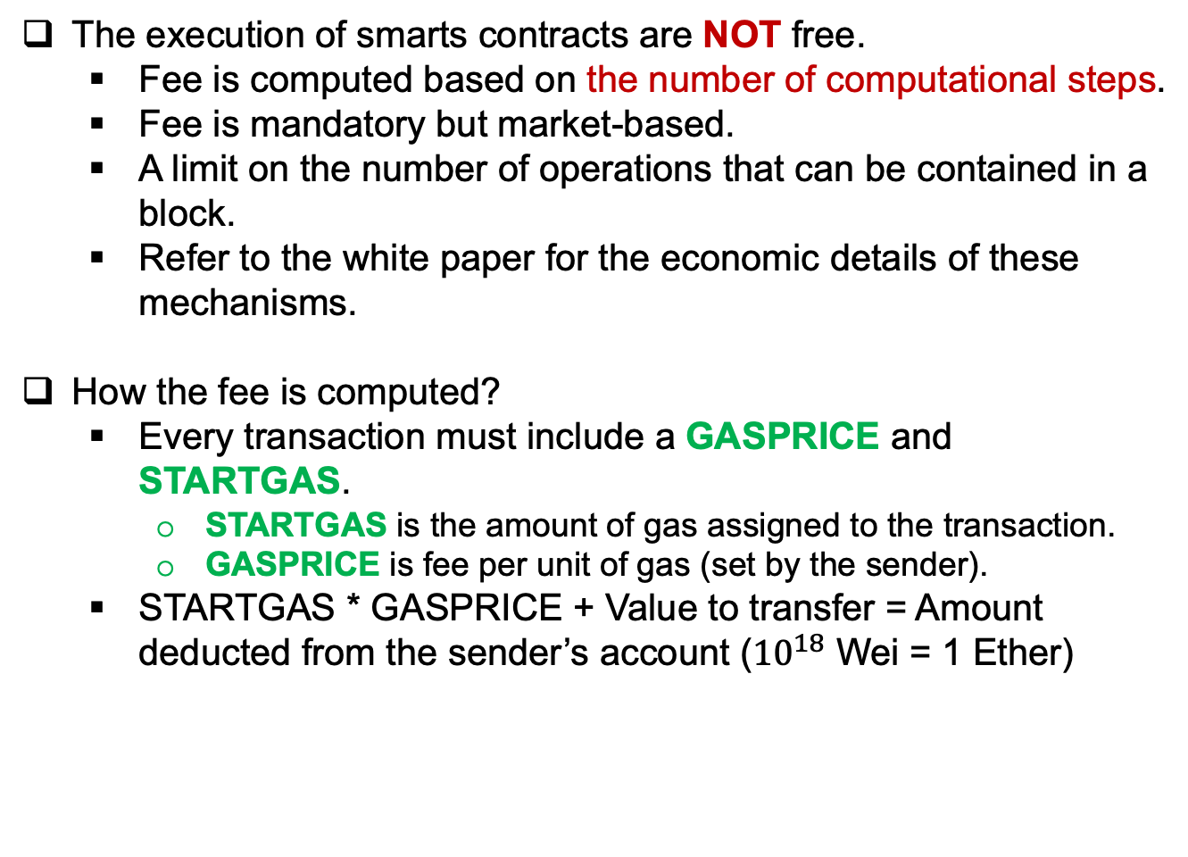
Execution Fee
The execution of smarts contracts are NOT free.
Fee is computed based on the number of computational steps.
Fee is mandatory but market-based.
A limit on the number of operations that can be contained in a block.
Refer to the white paper for the economic details of these mechanisms.
How the fee is computed?
Every transaction must include a GASPRICE and STARTGAS.
STARTGAS is the amount of gas assigned to the transaction.
GASPRICE is fee per unit of gas (set by the sender).
STARTGAS * GASPRICE + Value to transfer = Amount deducted from the sender’s account (${10}^{18}$ Wei = 1 Ether)

Slide 50
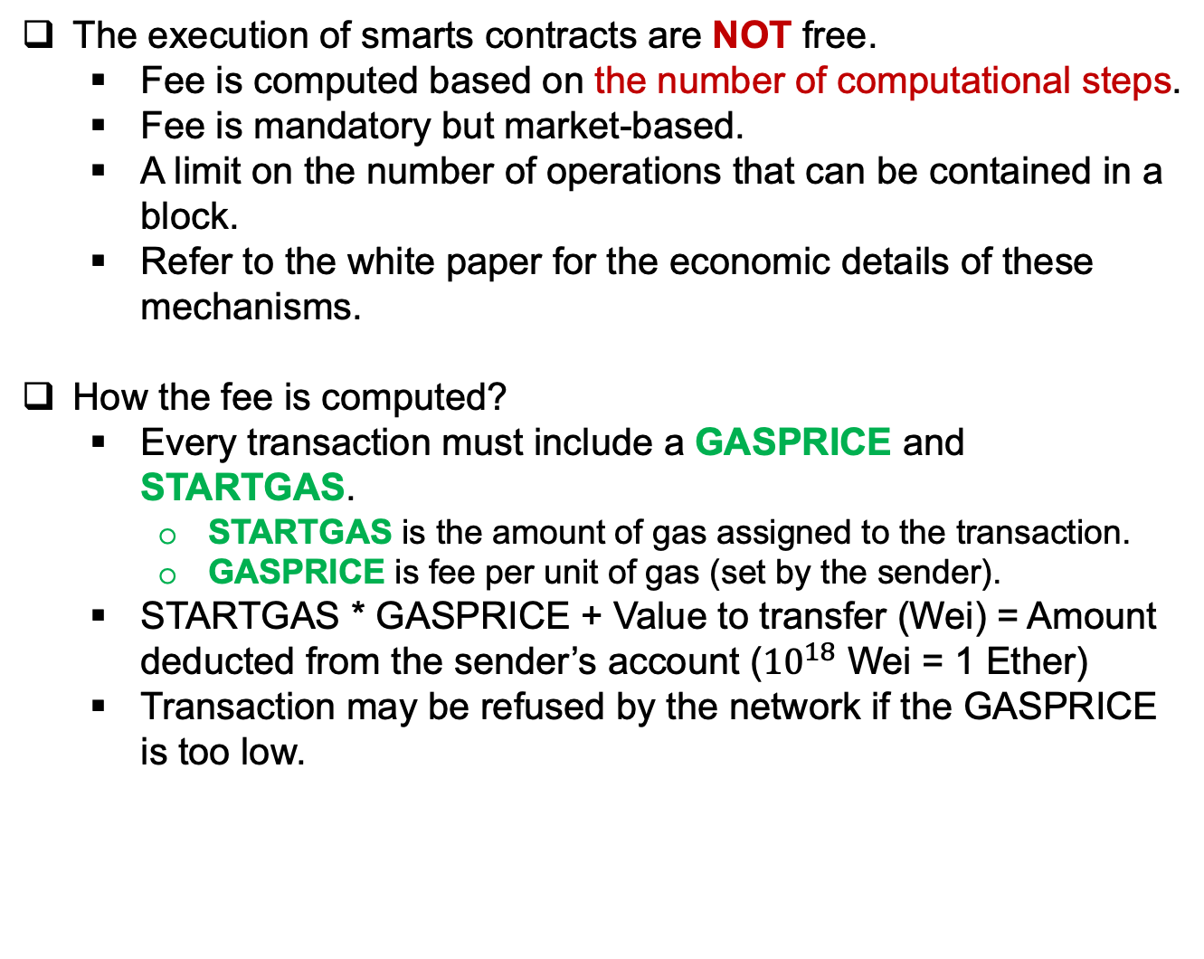
Execution Fee
The execution of smarts contracts are NOT free.
Fee is computed based on the number of computational steps.
Fee is mandatory but market-based.
A limit on the number of operations that can be contained in a block.
Refer to the white paper for the economic details of these mechanisms.
How the fee is computed?
Every transaction must include a GASPRICE and STARTGAS.
STARTGAS is the amount of gas assigned to the transaction.
GASPRICE is fee per unit of gas (set by the sender).
STARTGAS * GASPRICE + Value to transfer (Wei) = Amount deducted from the sender’s account (${10}^{18}$ Wei = 1 Ether)
Transaction may be refused by the network if the GASPRICE is too low.

Slide 51

Execution Fee
Gas $≈$ A counter of the number of computation steps

Slide 52
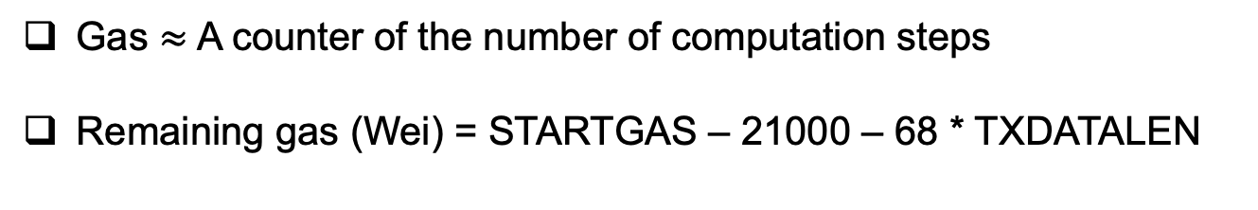
Execution Fee
Gas $≈$ A counter of the number of computation steps
Remaining gas (Wei) = STARTGAS – 21000 – 68 * TXDATALEN

Slide 53
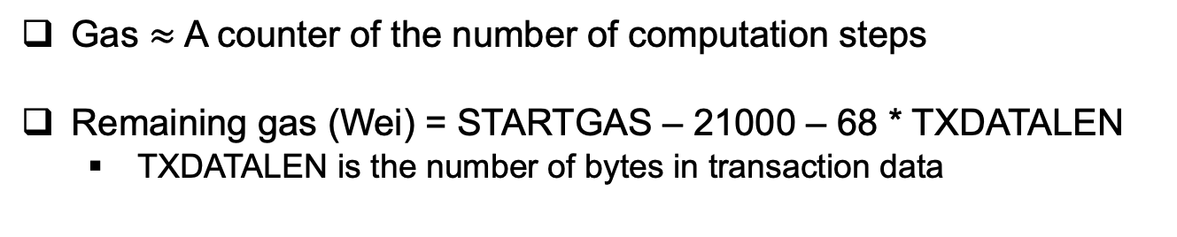
Execution Fee
Gas $≈$ A counter of the number of computation steps
Remaining gas (Wei) = STARTGAS – 21000 – 68 * TXDATALEN
TXDATALEN is the number of bytes in transaction data

Slide 54
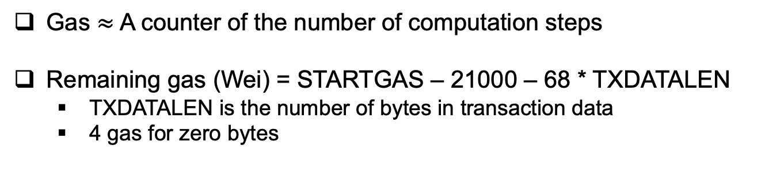
Execution Fee
Gas $≈$ A counter of the number of computation steps
Remaining gas (Wei) = STARTGAS – 21000 – 68 * TXDATALEN
TXDATALEN is the number of bytes in transaction data
4 gas for zero bytes

Slide 55
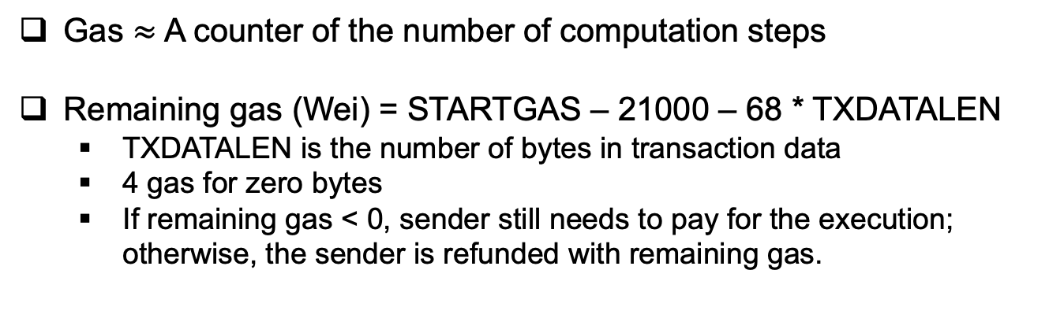
Execution Fee
Gas $≈$ A counter of the number of computation steps
Remaining gas (Wei) = STARTGAS – 21000 – 68 * TXDATALEN
TXDATALEN is the number of bytes in transaction data
4 gas for zero bytes
If remaining gas < 0, sender still needs to pay for the execution; otherwise, the sender is refunded with remaining gas.

Slide 56
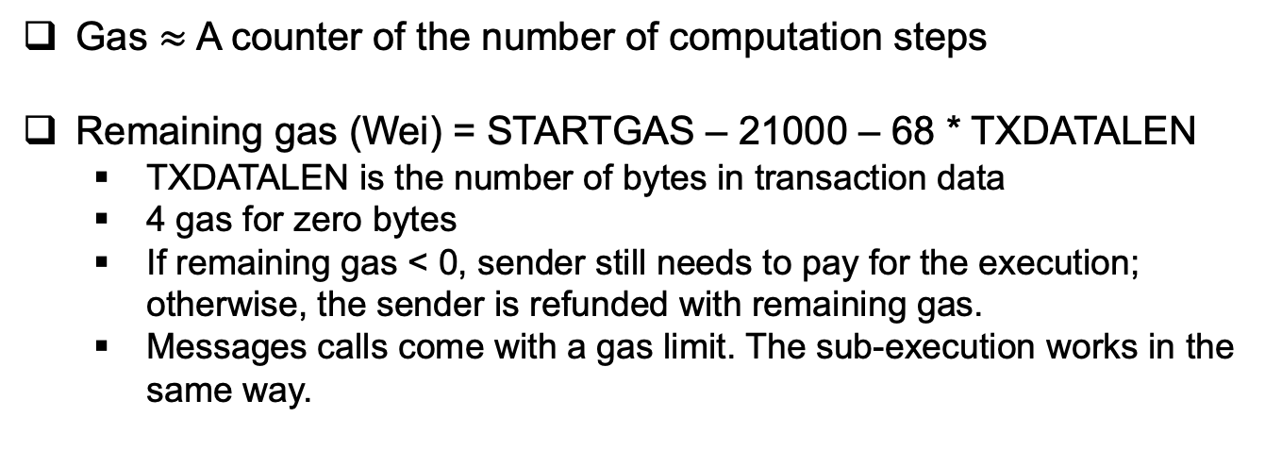
Execution Fee
Gas $≈$ A counter of the number of computation steps
Remaining gas (Wei) = STARTGAS – 21000 – 68 * TXDATALEN
TXDATALEN is the number of bytes in transaction data
4 gas for zero bytes
If remaining gas < 0, sender still needs to pay for the execution; otherwise, the sender is refunded with remaining gas.
Messages calls come with a gas limit. The sub-execution works in the same way.

Slide 57
Data Structure of Ethereum Blocks

Slide 59
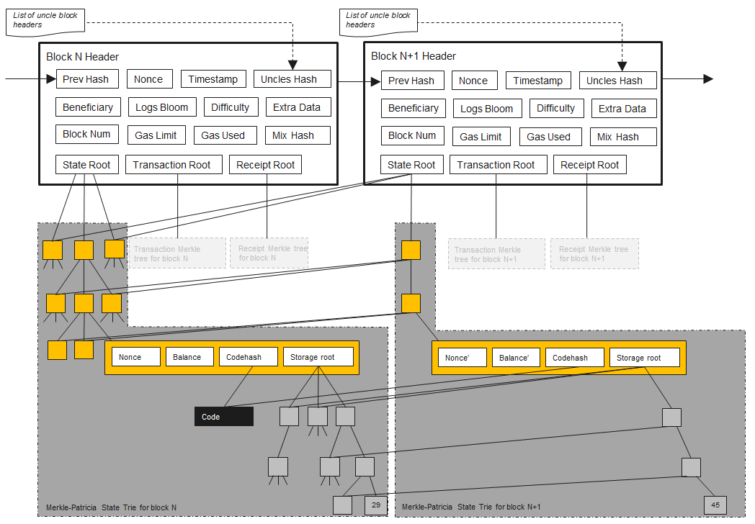

Slide 60
Notes:
State root, Transaction Root, Receipt Root and the Strorage Root are roots of a data structure called Modified Merkle Patricia Tree, aka Trie.
Light clients only store the block headers of the Ethereum blockchain.
A light client can verify the inclusion of a transaction; and
simply verify a payment.

Slide 61
The Trie Database of Ethereum
Notes:
The core data structure of Ethereum is an optimized implementation of Merkle Patricia Tree (aka Trie).

Slide 62
Radix Tree/Prefix Tree
Each path originated from the root node corresponds to a key:value pair. The symbols along the path compose the key and end node is associated with the value.
E.g., i:11, ted:4, A:15, in:5.
https://en.wikipedia.org/wiki/Trie
Notes:
Trie comes from retrieve.

Slide 63
Radix Tree/Prefix Tree
The core data structure of Ethereum is an optimized implementation of Merkle Patricia Tree (aka Trie).
Radix Tree/Prefix Tree
Maximum depth of the tree == the maximum length of the key
For a hex radix tree, each node has 16 children.
https://en.wikipedia.org/wiki/Trie
Notes:
Radix tree is a tree-like database, where each branch is associated with a symbol.

Slide 64
Efficient Radix Tree

Slide 65
Merkle Tree
Merkle Tree provide an efficient way to prove the integrity and validity of your data.
Allows all nodes in a distributed system to quickly and efficiently identify data that has changed without having to send over all the data in order to make the comparison.
http://en.wikipedia.org/wiki/hash_tree
Notes:
Each leaf node of a Merkle tree is the hash of a data block
Each non-leaf node is the cryptographic hash of the concatenation all its children.
Even the slightest change to any of the data block will result in change to the root of the Merkle tree. This allows us to use the root as a means to prove the integrity and validity of the data blocks.
Merkle trees are computationally easy and fast.
Minimal storage and bandwidth overhead. Root instead of all the data blocks.
With Merkle tree, we can have light client, who only keeps the block headers of the Ethereum blockchain.

Slide 66
Merkle Patricia Tree (Trie)
The Merkle Patricia Tree is a combination of Merkle tree and Radix tree.
Root for verification of data integrity
Efficient insertion, deletion and lookups.
Ethereum uses a Modified Merkle Patricia Tree, aka Trie.
The Root node in a Trie is a cryptographic fingerprint of the entire data structure.

Slide 67
LevelDB Database
LevelDB database is an open source Google key-value storage library.

Slide 68
LevelDB Database
LevelDB database is an open source Google key-value storage library.
Ethereum implementations use LevelDB database (Go-Ethereum, CPP-Ethereum, Py-Ethereum) for data storage.

Slide 69
LevelDB Database
LevelDB database is an open source Google key-value storage library.
Ethereum implementations use LevelDB database (Go-Ethereum, CPP-Ethereum, Py-Ethereum) for data storage.
LevelDB database uses lexicographic sorting:
The LevelDB iterator iterates the stored (key, value) bindings through the keys in lexicographic order.

Slide 70
LevelDB Database
LevelDB database is an open source Google key-value storage library.
Ethereum implementations use LevelDB database (Go-Ethereum, CPP-Ethereum, Py-Ethereum) for data storage.
LevelDB database uses lexicographic sorting:
The LevelDB iterator iterates the stored (key, value) bindings through the keys in lexicographic order.
Efficient for insertion, lookup, and deletion of (key, value) bindings.

Slide 71
LevelDB Database
LevelDB database is an open source Google key-value storage library.
Ethereum implementations use LevelDB database (Go-Ethereum, CPP-Ethereum, Py-Ethereum) for data storage.
LevelDB database uses lexicographic sorting:
The LevelDB iterator iterates the stored (key, value) bindings through the keys in lexicographic order.
Efficient for insertion, lookup, and deletion of (key, value) bindings.

Slide 72
Hex-Prefixed (HP) Encoding
The Ethereum trie uses HP-encoded path.
Each branch is labeled by a hex digit (0-1, a-f).

Slide 73
Hex-Prefixed (HP) Encoding
The Ethereum trie uses HP-encoded path.
Each branch is labeled by a hex digit (0-1, a-f).
Why HP-encoded path?
HP encoding Ethereum Addresses are based on the Hexadecimal format.
To disambiguate between different types of nodes.
To ensure each path is even length.
The Merkle tree will always be a whole number of bytes, which is important to a machine.

Slide 74
Hex-Prefixed (HP) Encoding
The Ethereum trie uses HP-encoded path.
Each branch is labeled by a hex digit (0-1, a-f).
Why HP-encoded path?
HP encoding Ethereum Addresses are based on the Hexadecimal format.
To disambiguate between different types of nodes.
To ensure each path is even length.
The Merkle tree will always be a whole number of bytes, which is important to a machine.
Skip the details of the HP encoding. Too many rules......

Slide 75
Hex-Prefixed (HP) Encoding
The Ethereum trie uses HP-encoded path.
Each branch is labeled by a hex digit (0-1, a-f).
Why HP-encoded path?
HP encoding Ethereum Addresses are based on the Hexadecimal format.
To disambiguate between different types of nodes.
To ensure each path is even length.
The Merkle tree will always be a whole number of bytes, which is important to a machine.
Skip the details of the HP encoding. Too many rules......
Ethereum’s encoding system is called Recursive Length Prefix (RLP), which will be replaced in the future because it cannot be optimized...
Notes:
The co-founder of Ethereum Vitalik Buterin recently said on Twitter he has many regrets with Ethereum 1.0, one of which is RLP.

Slide 76
Recursive Length Prefix (RLP)
RLP is used by Ethereum for data serialization.

Slide 77
Recursive Length Prefix (RLP)
RLP is used by Ethereum for data serialization.
Data serialization is the process of converting structured data to a format that allows sharing or storage of the data in a form that allows recovery of its original structure.

Slide 78
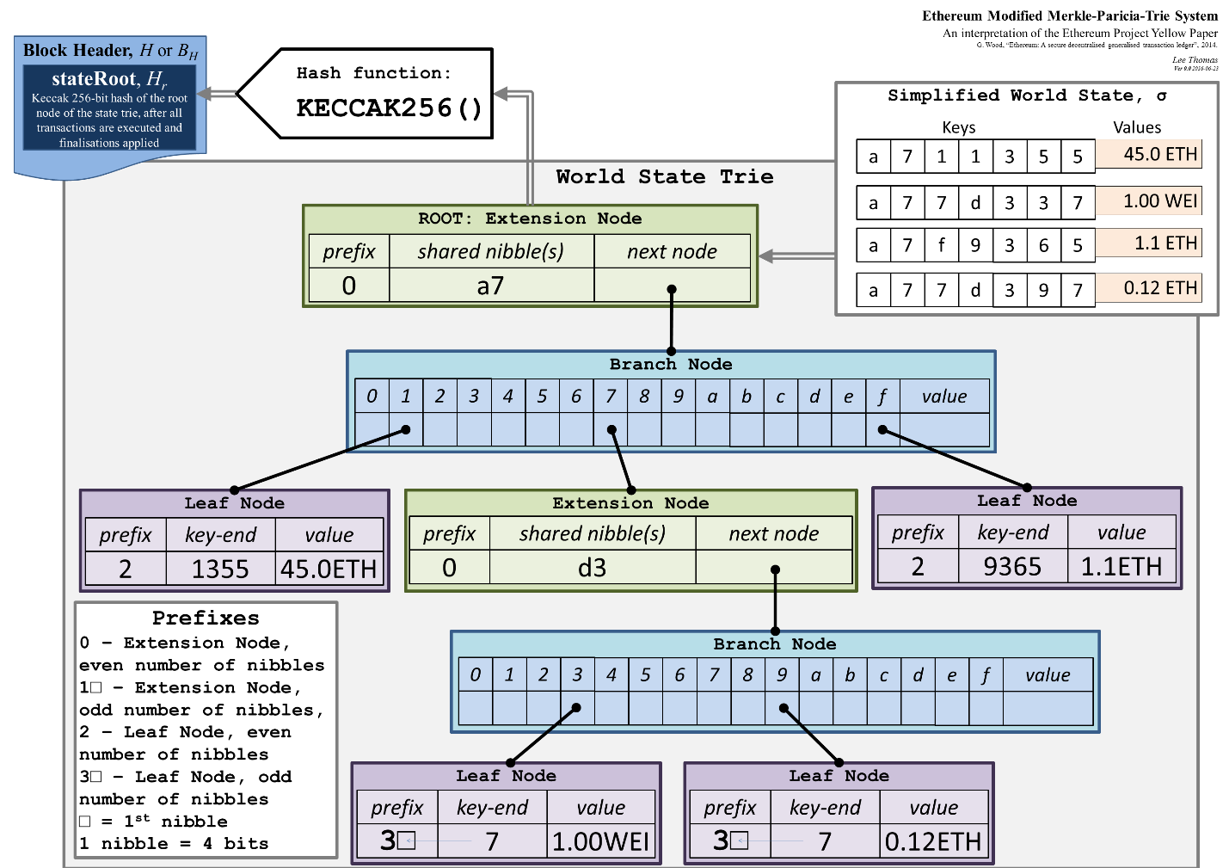
Notes:
The “next node” bucket in the “Extension Node” is a hash pointing to the next node.

Slide 79
The Four Tries
Receipt Tree
To record the outcome of a transaction
State Tree
To record the global state of the system.
Storage Tree
To record all the contracts’ data. One for each contract.
Transaction Tree
To record transactions.
The root of each trie is a Keccak 256-bit hash

Slide 80
Notes:
The Storage Tree’s root lives within the RLP encoded data value within the State Trie.

Slide 81
Reference
Haber, Stuart, and W. Scott Stornetta. “How to time-stamp a digital document.” In Conference on the Theory and Application of Cryptography, pp. 437-455. Springer, Berlin, Heidelberg, 1990. Available: https://www.anf.es/pdf/Haber_Stornetta.pdf
“Ethereum Development Tutorial”. Available: https://github.com/ethereum/wiki/wiki/Ethereum-Development-Tutorial
Dustin Brickwood, “Understanding Trie Databases in Ethereum”, Aug 2, 2018. Available: https://medium.com/shyft-network-media/understanding-trie-databases-in-ethereum-9f03d2c3325d

